Slide 1
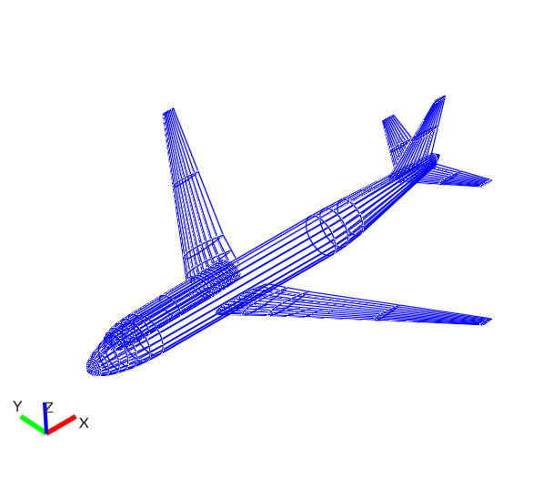
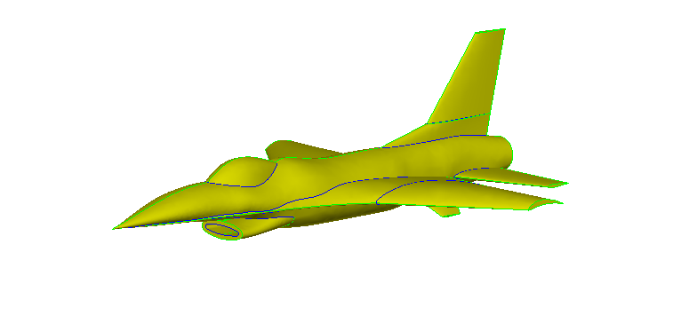
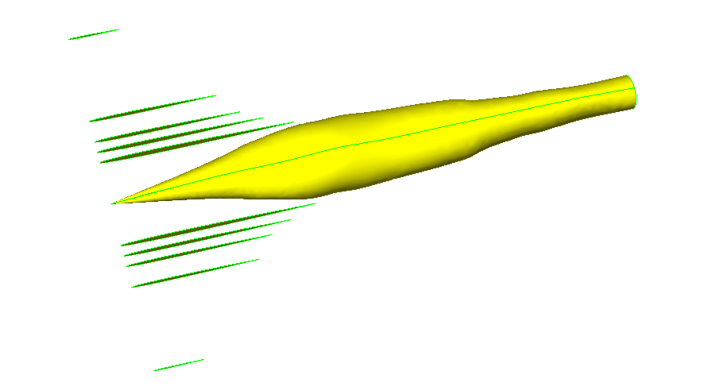
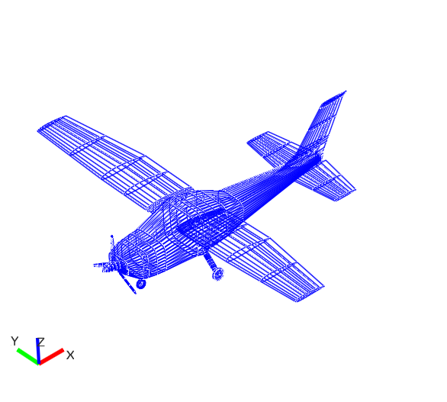
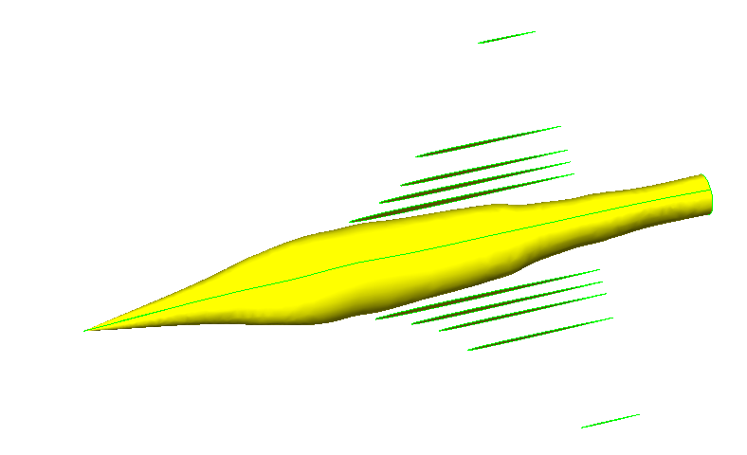
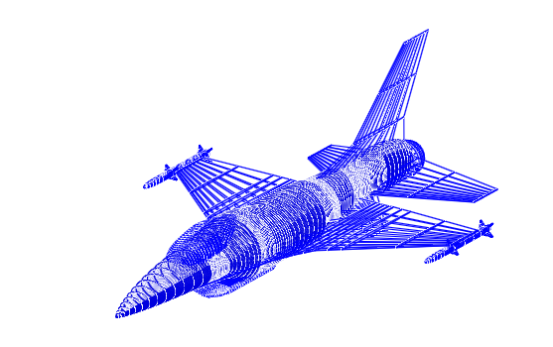
Qualitative Modeling of Aircraft Geometries for Comparison with Numerical Methods
Open VSP
Engineering Sketch Pad
Build Methodology
Boeing 747-400
Build, offset, scale cross-sections
F16 Fighting Falcon
Build Time: 20+ hrs
Cessna 182
Translate and blend
F16 Fighting Falcon

